Slide 1
ADVANCED PROPULSION SYSTEMS

Slide 2
TYPES
ELECTRIC PROPULSION
NUCLEAR PROPULSION
ION PROPULSION
SOLAR SAIL

Slide 3
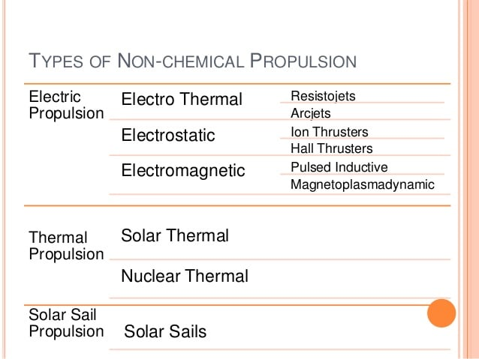

Slide 4
SUBSYSTEM
A RAW ENERGY SOURCE SUCH AS SOLAR OR NUCLEAR ENERGY WITH ITS AUXILARIES SUCH AS CONCENTRATORS, HEAT CONDUCTORS, PUMPS, PANELS, RADIATORS, AND /OR CONNTROLS.
CONVERSION DEVICES TO TRANSFORM THIS ENERGY INTO ELECTRICAL FORM AT THE PROPER VOLTAGE, FREQUENCY, PULSE RATE, AND CURRENT SUITABLE FOR THE ELECTRICAL PROPULSION SYSTEM.
A PROPELLANT SYSTEM FOR STORING, METERING, AND DELIVERING THE PROPALLANT.
ONE OR MORE THRUSTERS TO CONVERT THE ELECTRIC ENERGY INTO KINETIC ENERGY OF THE EXHAUST.

Slide 5
TYPES
ELECTROTHERMAL: PROPLLANT IS HEATED ELECTRICALLY AND EXPANDED THERMODYNAMICALLY I.E.’,THE GAS IS ACCELERATED TO SUPERSONIC SPEEDS THROUGH A NOZZLE, AS IN THE CHEMICAL ROCKET.
ELECTROSTATIC: ACCELERATION IS ACHIEVED BY THE INTERACTION OF ELECTROSTATIC FIELDS ON NON-NEUTRAL OR CHARGED PROPELLANT PARTICLES SUCH AS ATOMIC IONS, DROPLETS, OR COLLOIDS.
ELECGTROMAGNETIC: ACCELERATION IS ACHIEVED BY THE INTERACTION OF ELECTRIC AND MAGNETIC FIELDS WITHIN A PLASMA.MODERATELY DENSE PLASMAS ARE HIGH-TEMPERATURE OR NONEQUILIBRIUM GASES, ELECTRICALLY NEUTRAL AND REASONABLY GOOD CONDUCTORS OF ELECTRICITY.

Slide 6
PRINCIPLE
THE BASIC PRINCIPLE OF ELECTRIC PROPULSION IS TO APPLY ELECRICAL ENERGY TO THE PROPELLANT FROM AN EXTERNAL POWER SOURCE.
THE SIMPLEST WAY IS TO HEAT THE PROPELLANT WITH HOT WIRE COIL,THROUGH WHICH AN ELECTRIC CURRENT PASSES.

Slide 7
ELECTRIC THRUSTERS
ELECTRIC THRUSTER CAN BE DIVIDED INTO TWO BROAD CATEGORIES:
THOSE THAT USE ELECTRICITY TO HEAT THE PROPELLANT, WHICH EMERGES AS A NEUTRAL GAS, AND
THOSE WHICH USE ELECTRIC OR MAGNETIC FIELDS TO ACCELERATE IONS.

Slide 8
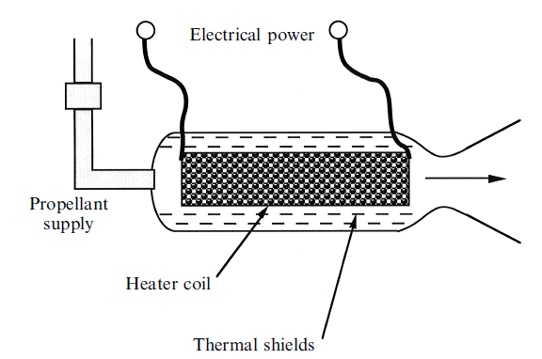
ELECTRO THERMAL THRUSTER

Slide 9
ELECTRO THERMAL PROPULSION
Electro-thermal propulsion systems are those systems in which electrical energy is used to heat propellants, thus producing thrust.
Principle
Electro-thermal systems heat propellants , which produce gases. The gases are then sent through a supersonic nozzle to produce thrust.

Slide 10
The basic electrothermal thruster, or ‘resisto-jet’, consists of a nozzle with a high expansion ratio, connected to a chamber in which the propellant is heated by a hot wire through which passes an electric current.
Same principle as chemical rocket.
For high thrust need efficient heating.
Since gases are bad conductors of heat, only a thin layer, in contact with the heater becomes hot; moreover, the wire radiates heat to the chamber walls, and so some power is lost.
The heat lost to the walls is essentially a loss of power in the thruster;η reduces.

Slide 11
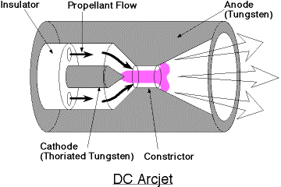
ARCJET THRUSTER

Slide 12
WORKING
Arc jets can be used to heat the propellants. In an arc jet, the propellant is heated by an electrical arc discharge.
The arc jet consists of a cathode and an anode, a constriction channel, nozzle and propellant injector. The arc in the arc jet is nothing but a beam of electrons that is emitted from the tip of the cathode and collected at the positively biased nozzle (anode).
Between the cathode and anode there is a narrow passageway called the constrictor. The electric field between the anode and the cathode causes the electrons to accelerate in the direction of anode (due to the attraction of the anode).

Slide 13
Gas is injected near the base of the cathode through injection ports.
The difficulty is the effect of the ions in the arc itself; these carry half the current, and strike the surface of the cathode at high speed, causing vaporization of the material.
The electrons affect the anodes to a lesser extent; in fact, some of the electrode material becomes ionized, and takes part in the current transport.
This limits the life of the anode and cathode and places a limit on the current that can be passed through the arc.

Slide 14
TYPICAL PROPELLANTS USED FOR ARC JET
AMMONIA
HYDROGEN
HYRAZINE
THERE ARE ALL LIGHTER TO PROVIDING HIGHER SPECIFIC IMPULSE AND LOWER ENGINE TEMPERATURES.

Slide 15
ELECTRO MAGNETIC PROPULSION

Slide 16
Electromagnetic propulsion is a type of electric propulsion in which propellant is heated to a plasma state and then accelerated.
Electromagnetic devices pass a large current through a small amount of gas to ionize the propellant. The ionized propellant (plasma) is accelerated by an electromagnetic force called the Lorentz force,
F = j x b
j = current, b= magnetic field.

Slide 17
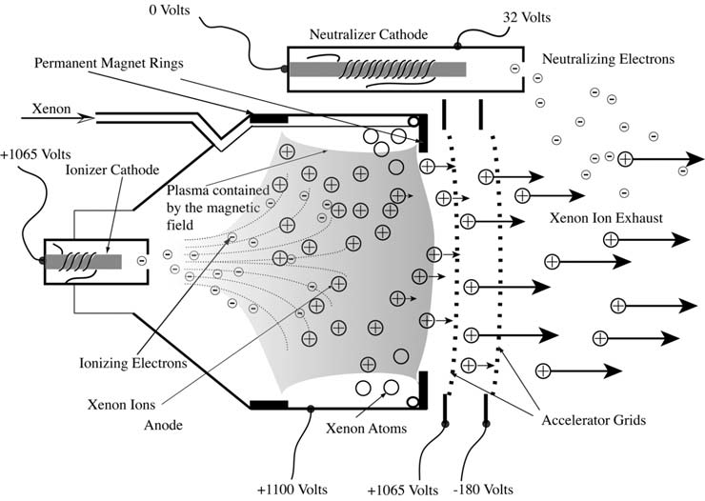
ION PROPULSION

Slide 18
Principle
In an ion rocket, the electrons from the atoms are striped off. Thus they are converted to ions. These atoms now have a net positive electric charge. Electrical forces accelerate these ions to high temperature without the use of thermal energy.

Slide 19
WORKING
The above figure shows a schematic diagram of a NSTAR ion thruster, as used on Deep Space 1.
The xenon gas enters the chamber from the left, and is ionized in the shaded region, confined by a magnetic field generated by strong permanent magnets.
The xenon ions drift into to gap between the two grids on the right and are accelerated by the electric field.
They pass out, to form the exhaust stream, and electrons are released from the neutralizer cathode to keep the spacecraft neutral.

Slide 20
The process takes place as follows:
In the ionization chamber, electric field provides velocity to ions. This provides thrust to the rocket as per the law of conservation of momentum.
Ionization is done by electron bombardment of the neutral atoms. Positive ions are produced by electron bombardment of neutral propellant atoms in a discharge chamber.
The impact of an electron on a xenon atom knocks away one of xenon's 54 electrons. This results in a xenon atom with a positive charge, or what is known as an ion.
Two molybdenum grids with a potential of 1,300 volts then accelerate these xenon ions between them, driving the ions out the exhaust at over 30 kilometers per second.

Slide 21
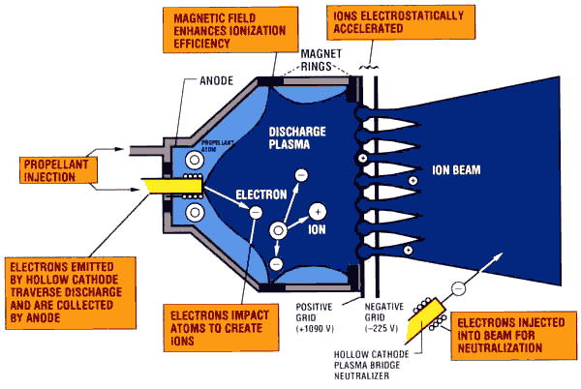

Slide 22
Ion engine propellants are chosen for a combination of
low ionization potential.
high atomic weight.
handling and storage properties.

Slide 23
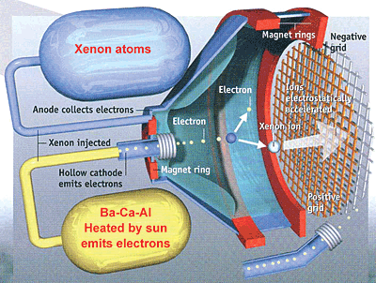

Slide 24
This technique of propulsion is still in its developmental stages.

Slide 25
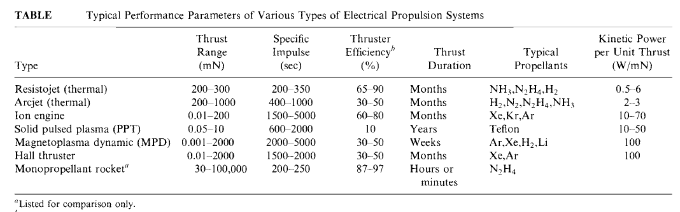

Slide 26
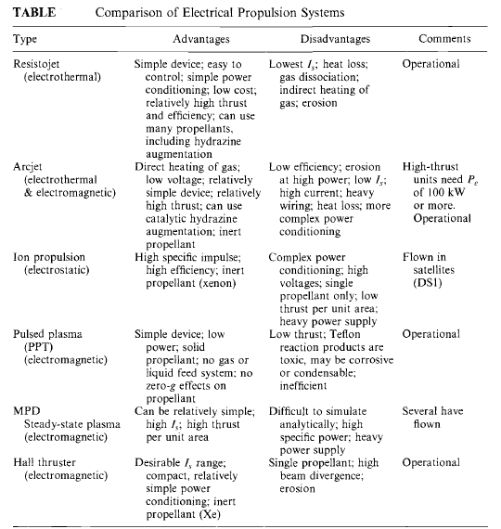

Slide 27
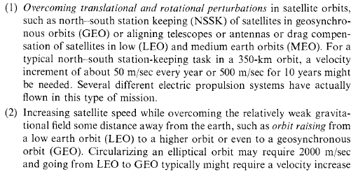
APPLICATION OF ELECTRIC PROPULSION SYSTEM

Slide 28
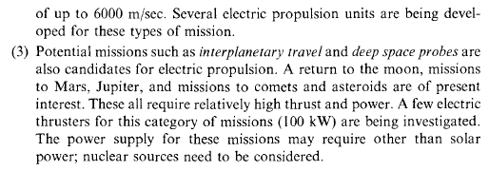

Slide 29
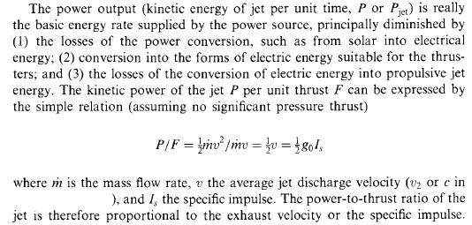

Slide 30
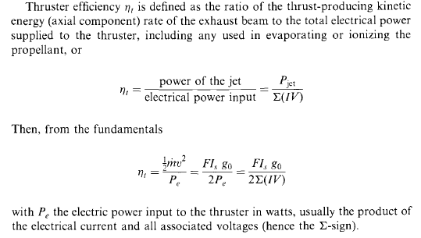

Slide 31
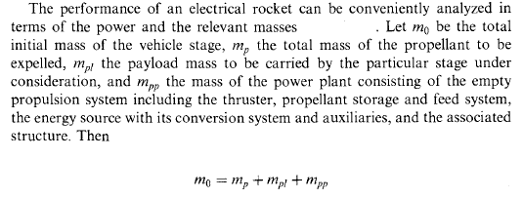

Slide 32
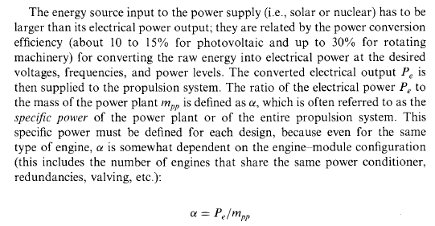

Slide 33


Slide 34
PROBLEM
Determine the flight characteristics of an electrical propulsion rocket for raising a low satellite orbit. Data given:
Is = 2000 s
F = 0.20 N
Duration = 4 weeks
Payload mass = 100 kg
α = 100 W/kg
η_{t} = 0.5

Slide 35
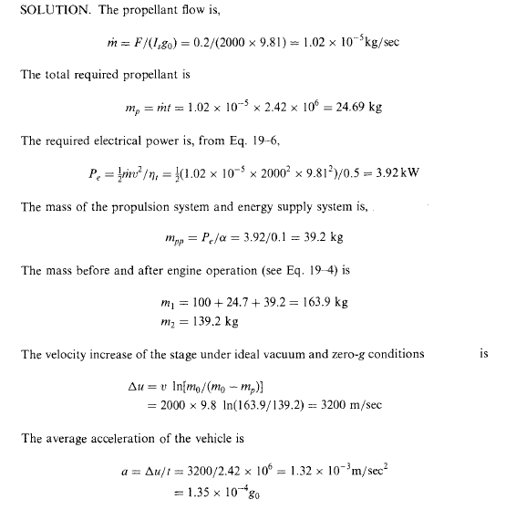

Slide 36
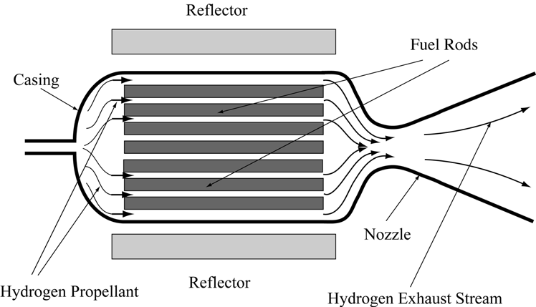
NUCLEAR THERMAL PROPULSION

Slide 37
PRINCIPLE
Hydrogen propellant enters the engine from the left, and is heated as it passes down the channels in the fuel rods.
The hot gas then expands down the nozzle to generate a high velocity exhaust stream.
The rate of fission and hence heat production is controlled by the reflector.

Slide 38
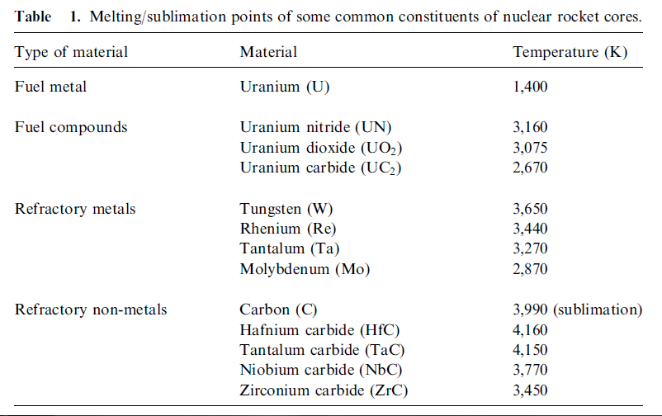

Slide 39
Solar Sails
Solar sails use photon “pressure” of force on thin, lightweight reflective sheet to produce thrust; ideal reflection of sunlight from surface produces 9 N/km² at 1 AU (1 AU = 146.9 x 10⁹ m).
Net force on solar sail perpendicular to surface.
As long as the sun shines, a solar sail will be able to produce thrust.

Slide 40
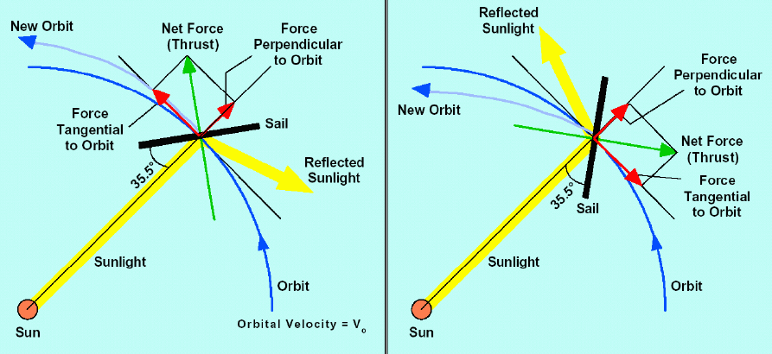

Slide 41
Working:
The spacecraft arranged with a large membrane mirror reflects light from the Sun or some other source. The radiation pressure on the mirror provides a small amount of thrust by reflecting photons. Tilting the reflective sail at angle from the Sun produces thrust at an angle normal to the sail.
In most designs, steering would be done with auxiliary vanes, acting as small solar sails to change the attitude of the large solar sail. The vanes would be adjusted by electric motors.
The sail is rotated slowly as the sail orbits around a planet so the thrust is in the direction of the orbital movement to move to higher orbit or against it to move to a lower orbit.
The best sort of missions for a solar sail involves a dive near the Sun, where the light is intense, and sail efficiencies are high.

Slide 42
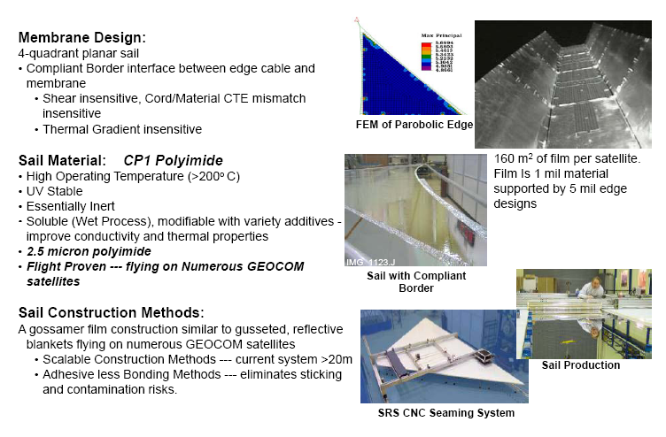
Design Features

Slide 43
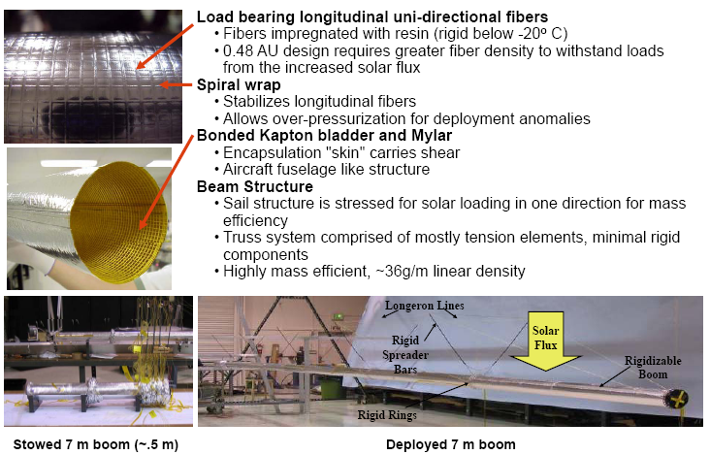

Slide 44
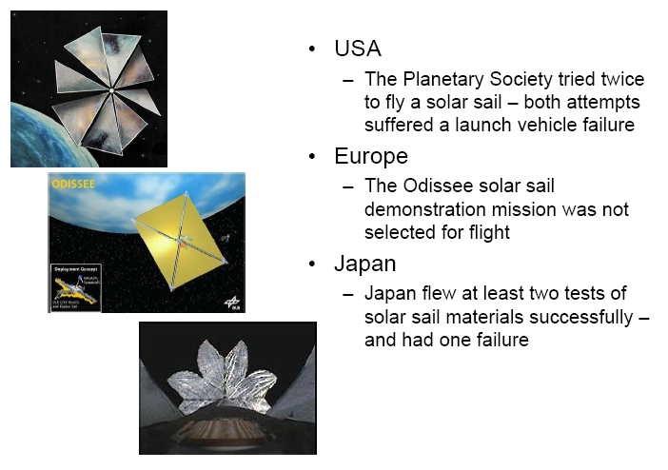
Applications For exploring the solar poles from a short distance, for observing the Sun and its near environment, etc.,

